Slide 1
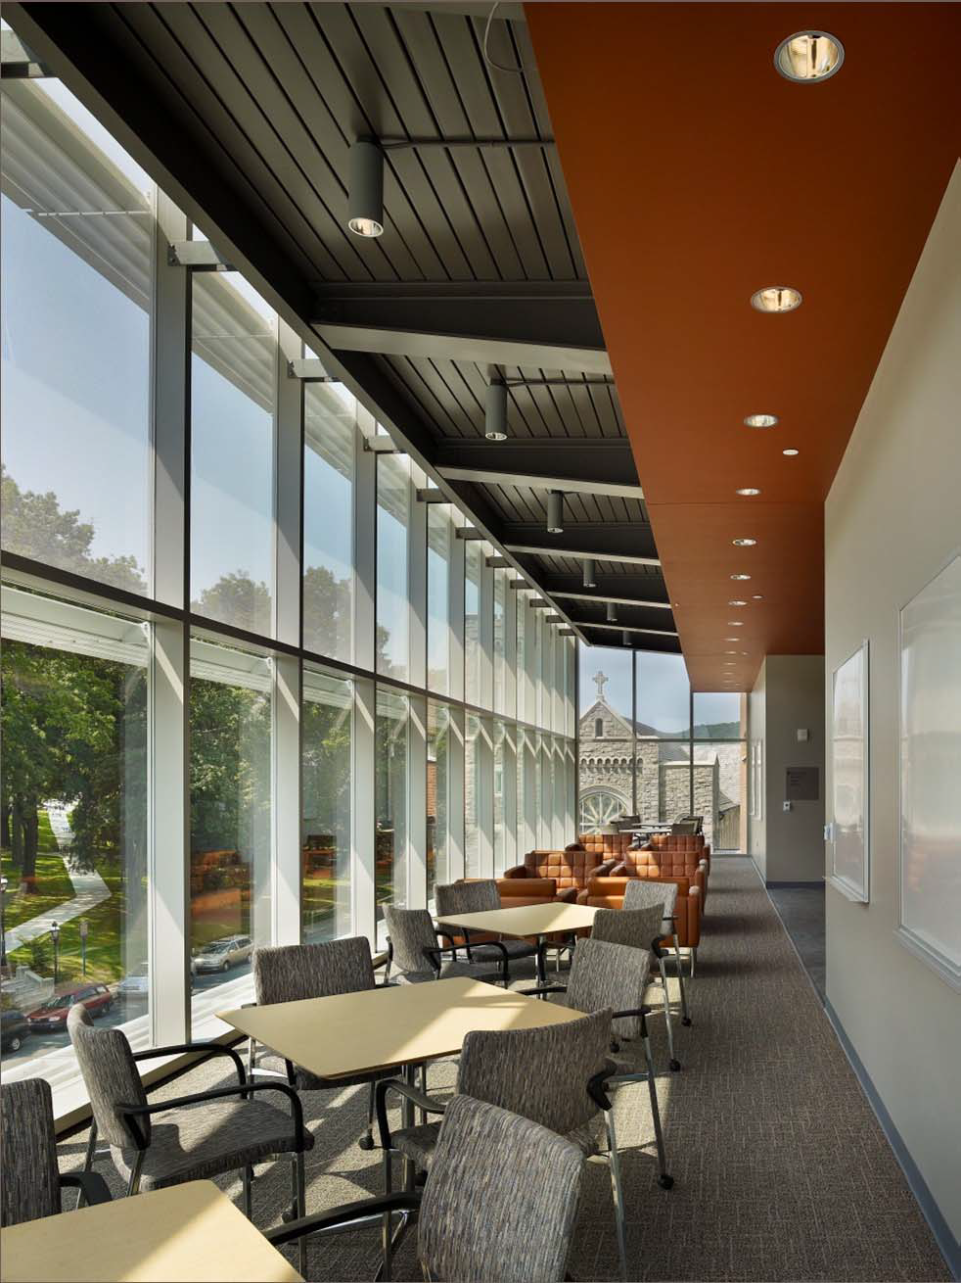
S.T.E.P.S. Building
Joseph Murray
Structural Option
Senior Thesis Presentation
The Pennsylvania State University
Advisor: Linda Hanagan

Slide 2
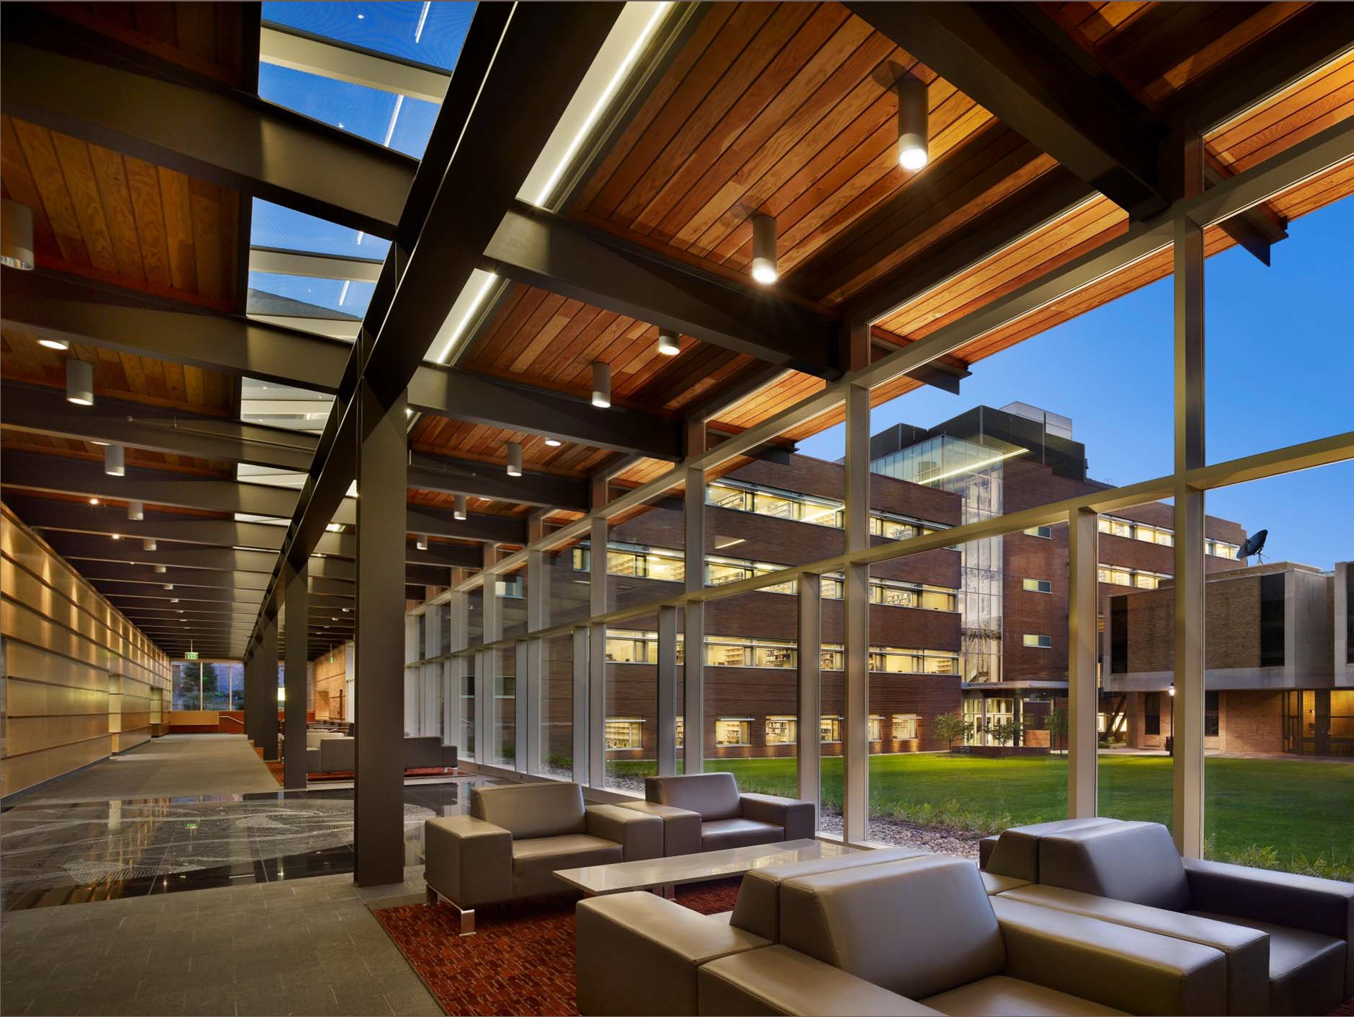
Building Statistics
S.T.E.P.S.: Science, Technology, Environment, and Policy Building
Education, laboratory, and research
Owner: Lehigh University
Location: Bethlehem, PA
5 story, 135,000 s.f. project
80’ to roofline of Wing C
Cost: $62 million
Construction: Aug. 2008 – Aug. 2010
Building Statistics
Structural System
Depth Proposal
Floor Design
Lateral System
Moment Connections
Braced Connections
Electrical Breadth
Construction Breadth

Slide 3
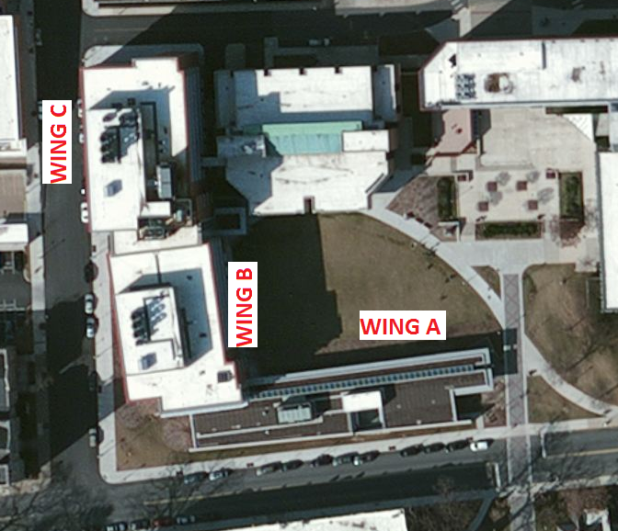
Building Statistics
Project Team:
CM: Alvin H. Butz Allentown, PA
Architect: BCJ Architects Philadelphia
Structural: CVM Structures Oaks, PA
Civil: Barry Isett & Assoc. Trexlertown, PA
MEP/Fire: Flack & Kurtz New York, NY
Landscape: Lager Raabe Skafte Philadelphia
Building Statistics
Structural System
Depth Proposal
Floor Design
Lateral System
Moment Connections
Braced Connections
Electrical Breadth
Construction Breadth

Slide 4
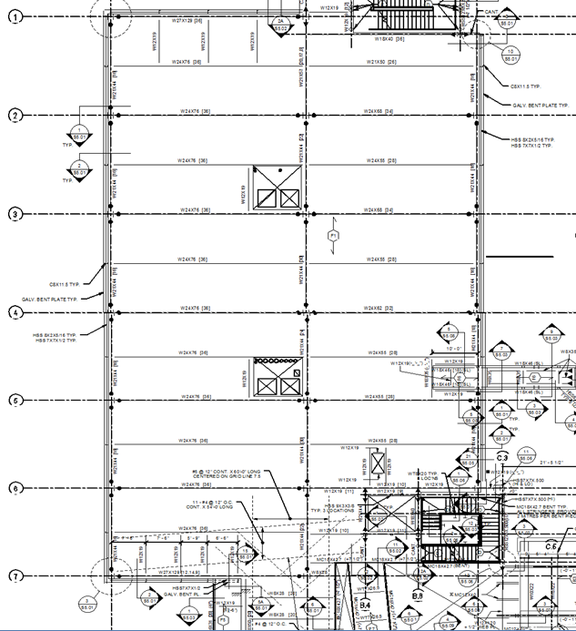
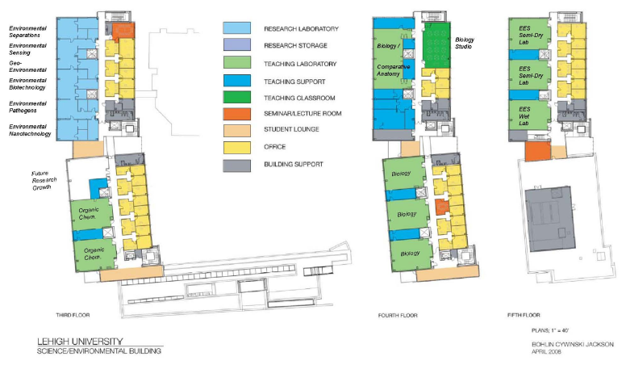
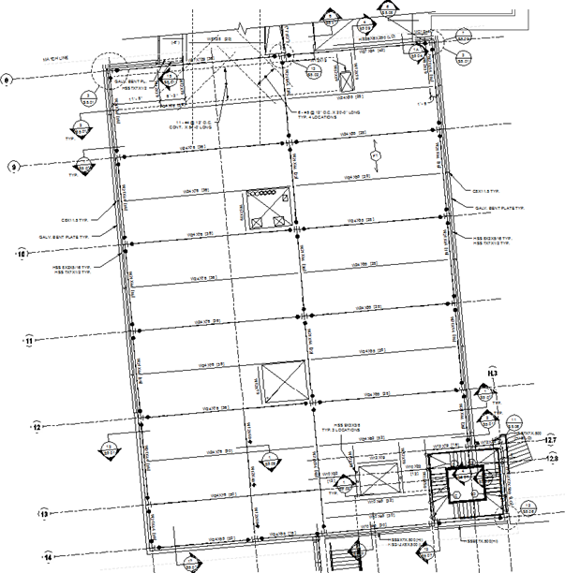
Existing Floor Plans
Wing C
Building Statistics
Existing Floor Plans
Structural System
Depth Proposal
Floor Design
Lateral System
Moment Connections
Braced Connections
Electrical Breadth
Construction Breadth
Wing B

Slide 5
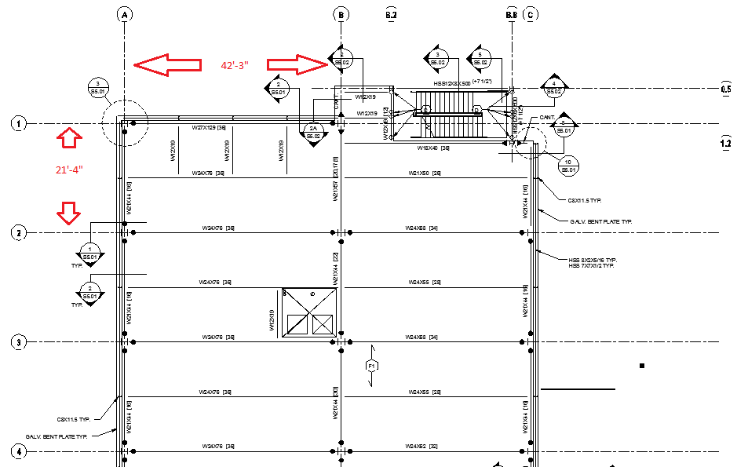
Existing Structural System
3” roof deck with varying topping
3” composite floor deck with 4.5” topping
W24 beams framing into W21 girders
Beam spacing: 10’-8” on center
Beam span: 42’-3”
Girder span: 21’-4”
LFRD: semi-rigid wind clips
Columns: W14x90 up to W14x192
Foundation: square footings
Building Statistics
Structural System
Depth Proposal
Floor Design
Lateral System
Moment Connections
Braced Connections
Electrical Breadth
Construction Breadth

Slide 6
Depth Proposal
Project Goals
1. Analyze the existing floor system for vibration resistance with AISC Design Guide 11
2. Redesign the floor to allow for 400x microscopes at moderate walking speeds
3. Redesign the lateral system with full moment frames and braced frames
4. Design a typical moment connection in detail
5. Design a typical braced connection in detail
Building Statistics
Structural System
Depth Proposal
Floor Design
Lateral System
Moment Connections
Braced Connections
Electrical Breadth
Construction Breadth

Slide 7
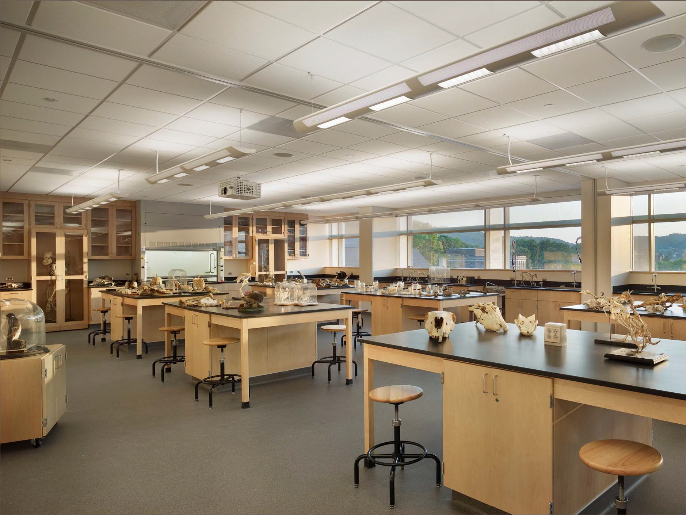
Floor Design
Floor vibration criteria were incorporated in design
Laboratory and research sections designed for sensitive equipment
Establish what equipment exist in the laboratories
Design the floor for specific equipment
Building Statistics
Structural System
Depth Proposal
Floor Design
Lateral System
Moment Connections
Braced Connections
Electrical Breadth
Construction Breadth

Slide 8
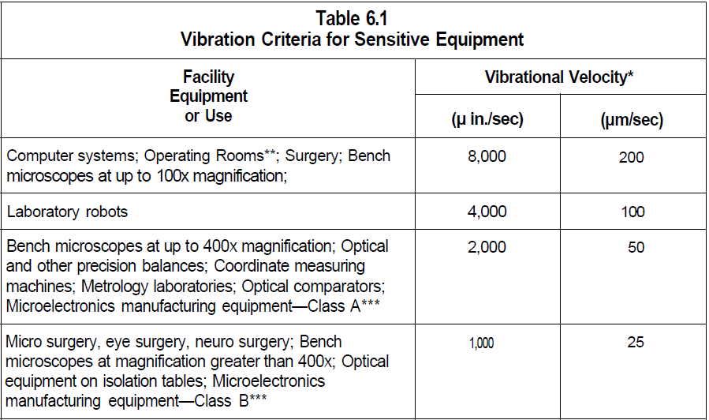
Floor Design
Means & Methods
AISC Design Guide 11: Floor Vibrations Due to Human Activity
Chapter 6: Sensitive Equipment
Based on natural frequency of floor
Current floor allows for 100x magnitude microscopes at “slow walking”
2000 microinches/second was chosen as the design criterion at “moderate walking” pace
Building Statistics
Structural System
Depth Proposal
Floor Design
Lateral System
Moment Connections
Braced Connections
Electrical Breadth
Construction Breadth
Upper image courtesy of E.M. Hines, Tufts University

Slide 9
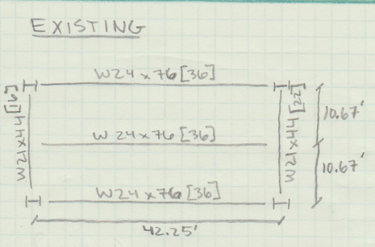
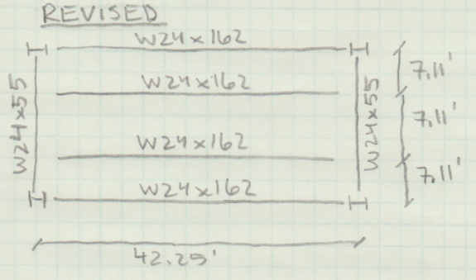
Floor Design
Impact of Redesign
Beam spacing decreased from 10’-8” to 7’-11” on center
Bay frequency rose from 3.7 to 5.3 Hz
Allows use of different equation
Bay floor weight increased by 21 psf
Only in sensitive laboratories
Floor depth could be increased
Move labs to one floor
Columns could be moved to decrease span
Building Statistics
Structural System
Depth Proposal
Floor Design
Lateral System
Moment Connections
Braced Connections
Electrical Breadth
Construction Breadth

Slide 10
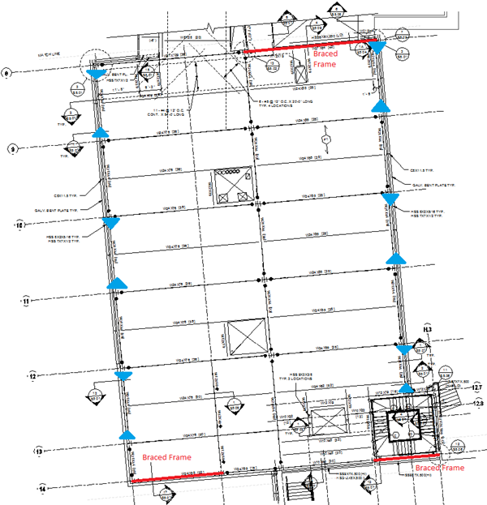
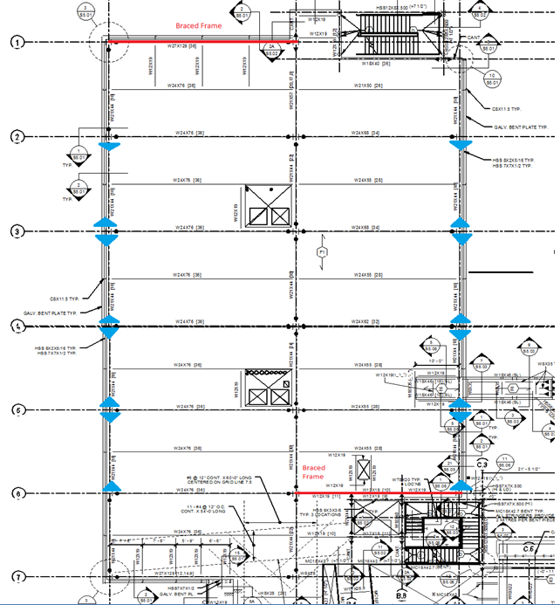
Lateral System
Building Statistics
Structural System
Depth Proposal
Floor Design
Lateral System
Moment Connections
Braced Connections
Electrical Breadth
Construction Breadth

Slide 11
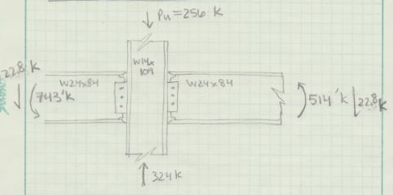
Moment Connection
Means & Methods
Wind clips in N/S direction replaced with full moment connections
AISC 14th Edition and AE 534 notes
2 rows of 7 moment frames
1.2D + .5L + .5S + 1.6W
Portal method to distribute loads
Frame analyzed for lowest story
Building Statistics
Structural System
Depth Proposal
Floor Design
Lateral System
Moment Connections
Braced Connections
Electrical Breadth
Construction Breadth

Slide 12
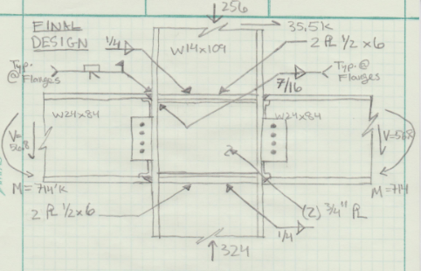
Moment Connection
Details
Flange Welded/ Web Bolted
Flange Connection
Full penetration welds with backers
Web Connection
5/16” plate with (4) 3/4” A325-N bolts
Column Reinforcement
Full depth 1/2” stiffeners required
(2) 3/4” doubler plates required
Building Statistics
Structural System
Depth Proposal
Floor Design
Lateral System
Moment Connections
Braced Connections
Electrical Breadth
Construction Breadth

Slide 13
Moment Connection
Impact of Redesign
Number of moment connections reduced
Field welds limited in connection
Column stiffening can be prefabricated
A stronger column could eliminate stiffeners and doubler plates
Building Statistics
Structural System
Depth Proposal
Floor Design
Lateral System
Moment Connections
Braced Connections
Electrical Breadth
Construction Breadth

Slide 14
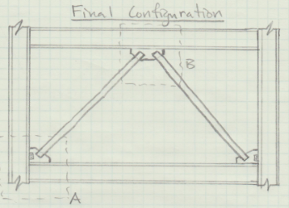
Braced Connection
Means & Methods
Wind clips in E/W direction to be replaced with 5 braced frames
AISC 14th Edition and AE 534 notes
1.2D + .5L + .5S + 1.6W
Concentric braces initially selected
Eccentric braces chosen due to span
HSS 4x4x1/2 selected as brace
Building Statistics
Structural System
Depth Proposal
Floor Design
Lateral System
Moment Connections
Braced Connections
Electrical Breadth
Construction Breadth

Slide 15
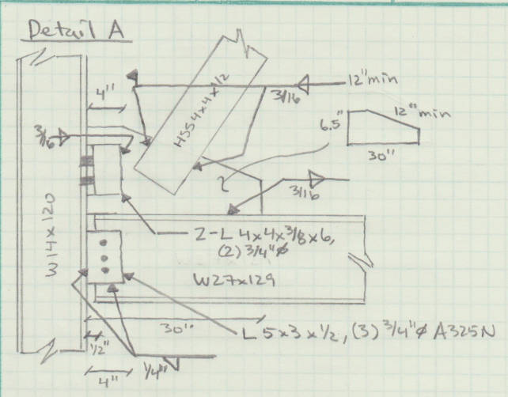
Braced Connection
Corner Brace Connection
1/2” gusset plate with 30x6.5x12 dimensions
HSS to Gusset: 3/16” field welds
Gusset to Column: 2-L 4x4x3/8x6
3/16” fillet welds to gusset
(2) 3/4” bolts to column
Gusset to Beam: 3/16” fillet welds
Beam to Column: L 5x3x1/2
1/4” fillet weld to column
(3) 3/4” bolts to beam
Building Statistics
Structural System
Depth Proposal
Floor Design
Lateral System
Moment Connections
Braced Connections
Electrical Breadth
Construction Breadth

Slide 16
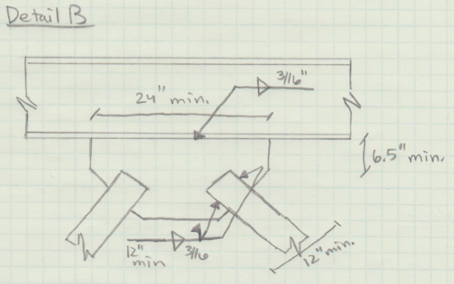
Braced Connection
Center of Beam Connection
1/2” gusset plate with 24x6.5x12 dimensions on both sides
HSS to Gusset: 3/16” field welds
12” minimum length
Gusset to Beam: 3/16” fillet welds
24” minimum length
Building Statistics
Structural System
Depth Proposal
Floor Design
Lateral System
Moment Connections
Braced Connections
Electrical Breadth
Construction Breadth

Slide 17
Braced Connection
Impact of Redesign
Wind clips were eliminated in the E/W direction of the building
Field welds limited in connection
Shorter brace spans could create more efficient braces
Would require adjusting interior columns
Impact on lateral loads seen by foundations in these frames
Building Statistics
Structural System
Depth Proposal
Floor Design
Lateral System
Moment Connections
Braced Connections
Electrical Breadth
Construction Breadth

Slide 18
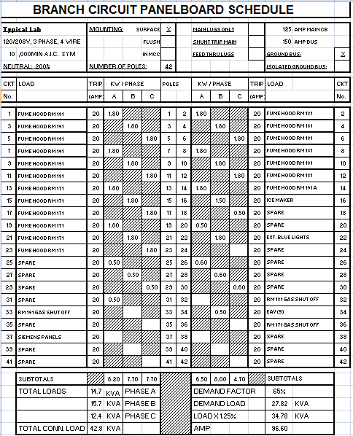
Electrical Breadth
Electrical System Details
1500 KVA Service Transformer
480 / 277V 3-Phase 4-Wire Secondary Feed to 3000-amp Distribution Panel
2 - 150 KVA Emergency Generators
277V T8, T5 and Compact Fluorescent Light Sources with Ballasts
Building Statistics
Structural System
Depth Proposal
Floor Design
Lateral System
Moment Connections
Braced Connections
Electrical Breadth
Construction Breadth

Slide 19
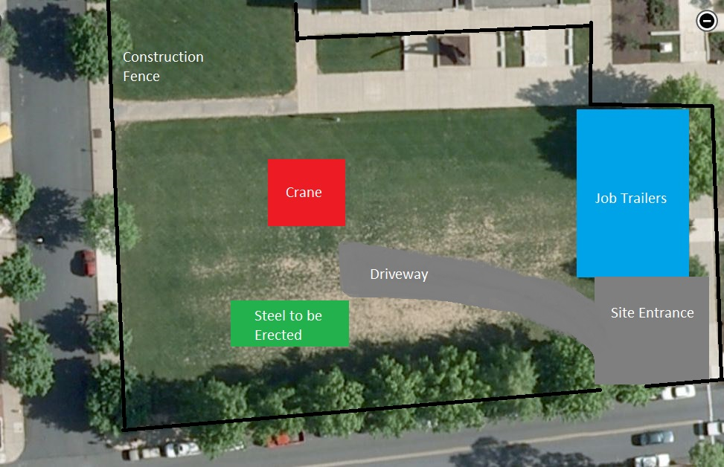
Construction Breadth
Building Statistics
Structural System
Depth Proposal
Floor Design
Lateral System
Moment Connections
Braced Connections
Electrical Breadth
Construction Breadth

Slide 20
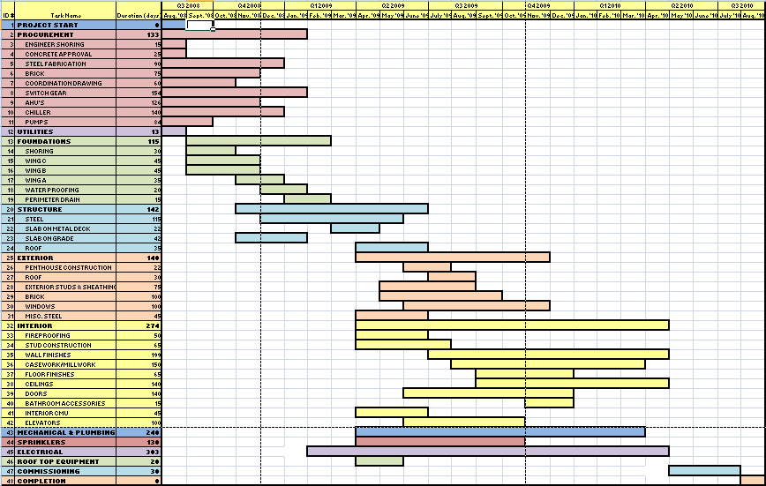
Construction Breadth
Start Finish
Project Start: 8/2008
Utilities: 8/2008 8/2008
Foundations: 9/2008 2/2009
Superstructure: 11/2008 6/2009
Exterior: 4/2009 11/2009
Interior: 4/2009 4/2010
Mech./Plumbing: 4/2009 3/2010
Electrical: 1/2009 5/2010
Commissioning: 5/2010 7/2010
Completion: 8/2010
Building Statistics
Structural System
Depth Proposal
Floor Design
Lateral System
Moment Connections
Braced Connections
Electrical Breadth
Construction Breadth

Slide 21
Acknowledgements
Advisors:
Dr. Linda Hanagan
Dr. Kevin Parfitt
Contacts:
Ms. Patricia Chase – Lehigh University
Jeff Pritchford – CVM Engineering
Eric Holland – Alvin Butz
Family: Father, Mother, and Sisters

